Slide 1
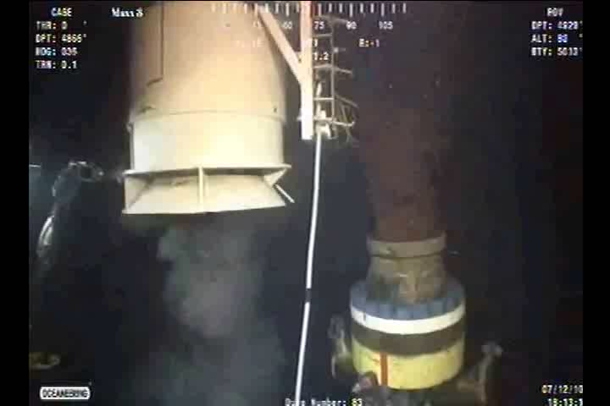
Landing Capping Stack
Source: TREX 160096
D-26007

