Slide 1
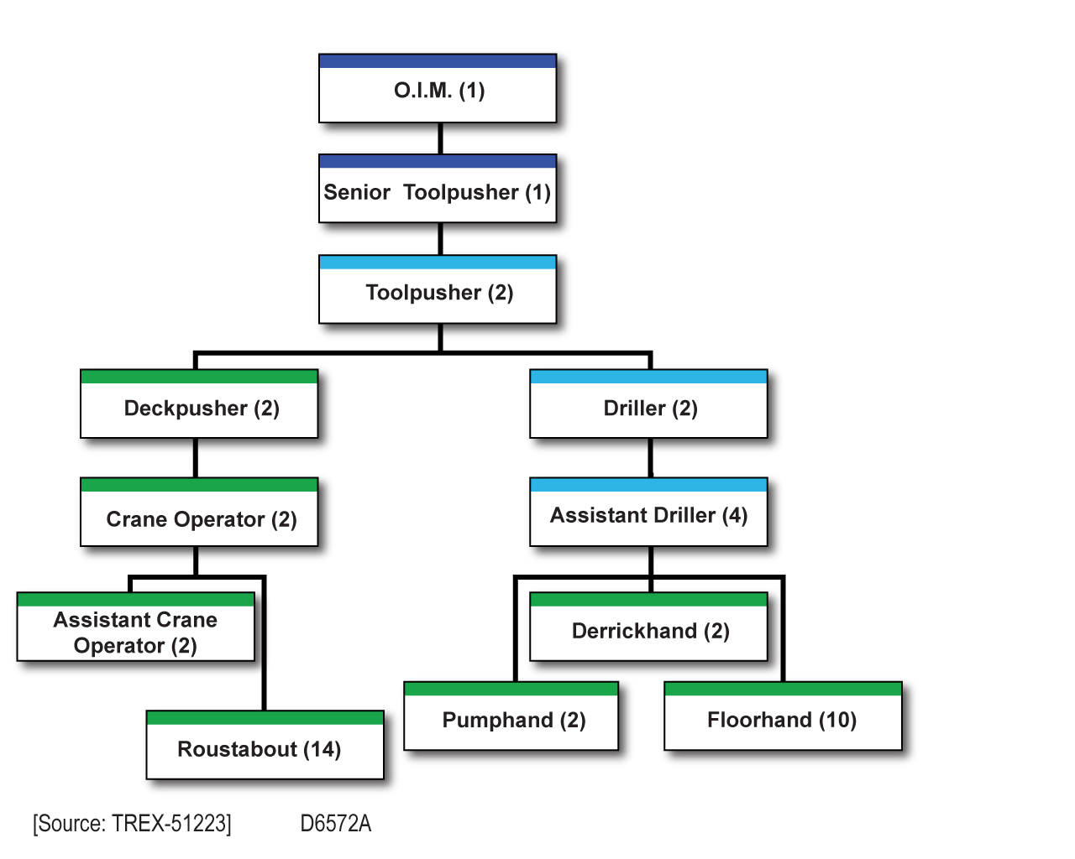
Drilling Operations

Slide 2
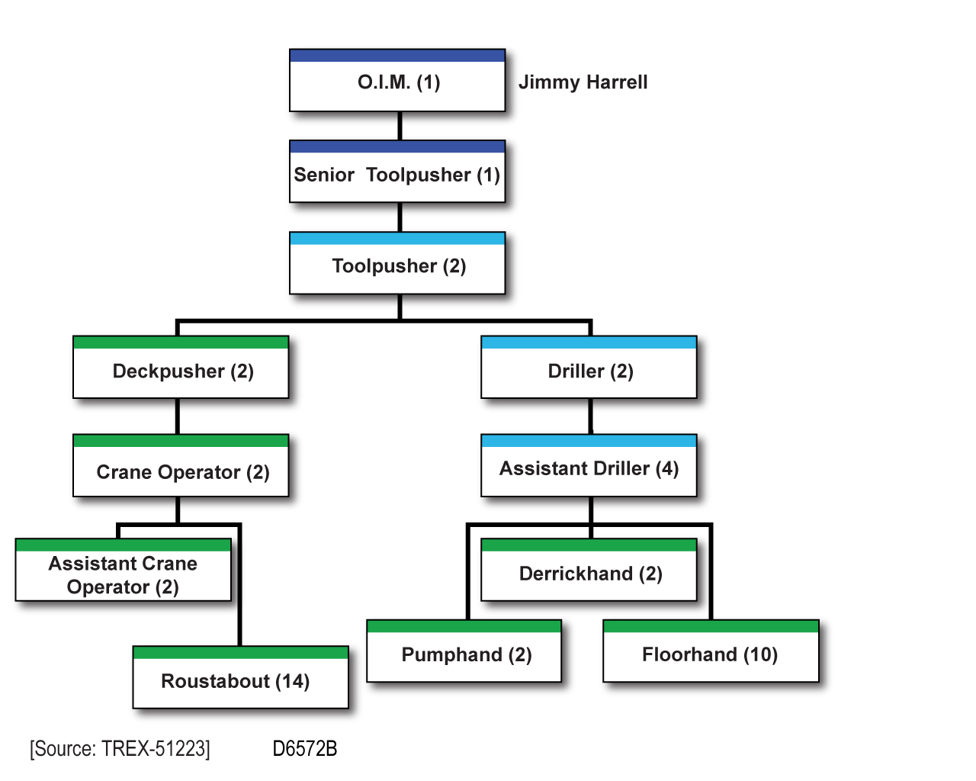
Drilling Operations

Slide 3
Drilling Operations

Slide 4
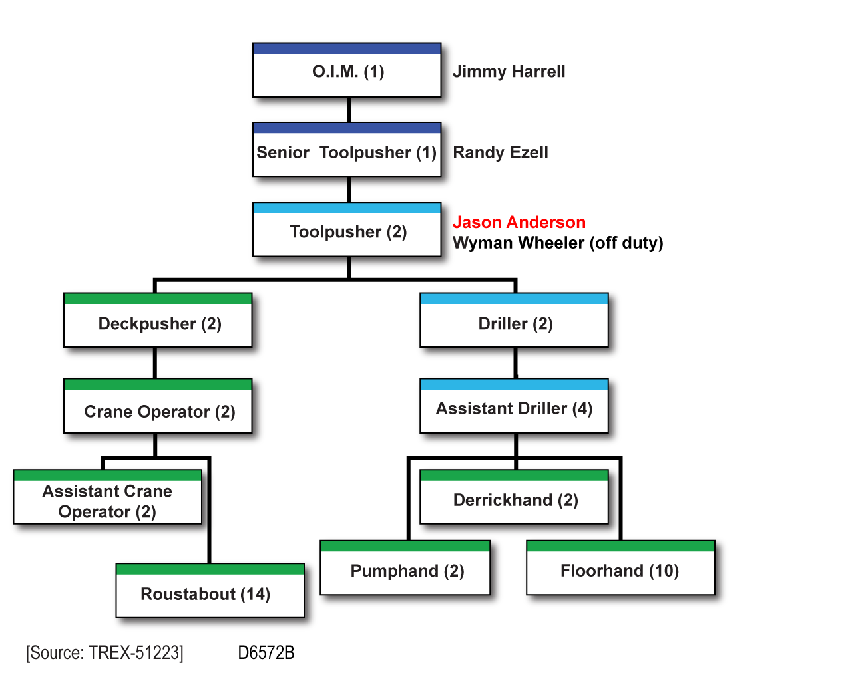
Drilling Operations

Slide 5
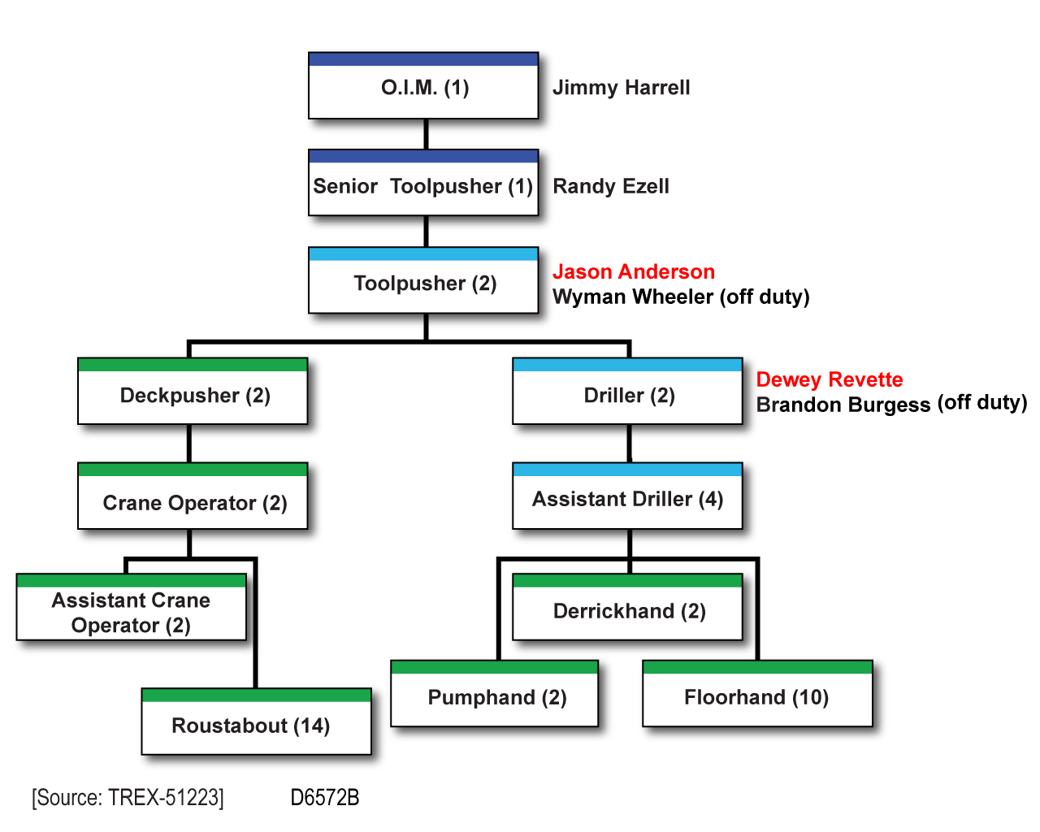
Drilling Operations

Slide 6
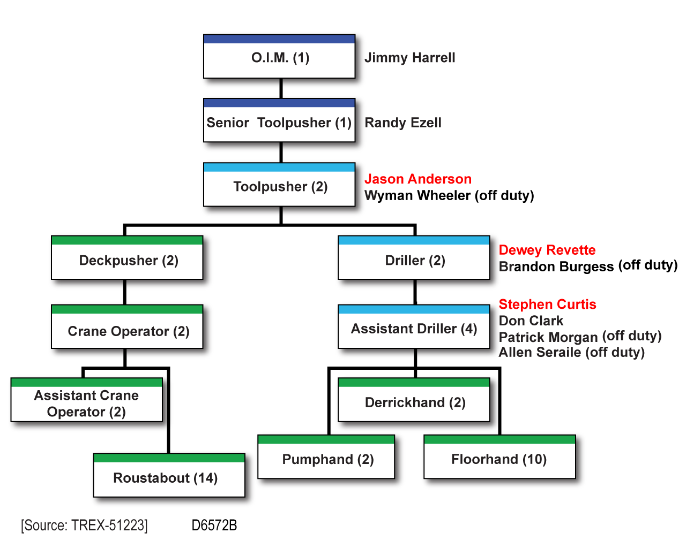
Drilling Operations

